Slide 1

Capstone Project : Review – 2 on
Secure QR Payment Using Visual Cryptography
Presented by the Batch No. : Team 10
Harsha Rajoor BU21CSEN0400241(TL)
Abdul Kalam BU21CSEN0400254
Tharun G V BU21CSEN0400267
Nirajkumar BU21CSEN0400239
Under the Guidance of
Gopal Murugan
Associate Professors
Department of Artificial Intelligence & Data Science
GITAM School of Technology, GITAM (Deemed to be University),
Bengaluru, Karnataka, INDIA.

Slide 2
CONTENTS
Abstract
Introduction
Literature Survey
Problem Statement
Objectives
Requirement Analysis
Identification of tools/technology/algorithms
Design Strategy (project workflow/ system design/ DFD/UML design)
Conclusion
References

Slide 3
Literature Survey
S. No. | Paper Details | Summary | Techniques/Algorithms Used | Research Gap
1 | Authors: Lina Ahmad et al. (2021), DOI: 10.1109/ICIM52229.2021.9417129 | Proposes secure online payment system using QR codes and visual cryptography to prevent fraud and data theft. | Visual Cryptography Scheme (VCS), QR Code Encryption, Android App, Public Key Cryptography | Static QR Codes, Performance optimization
2 | Authors: Dr. Praveena Narayanan et al. (2023), DOI: 10.1109/ICCCI56745.2023.10128604 | Enhances QR payment security by encrypting QR codes with visual cryptography and using a web app for generation and decryption. | Visual Cryptography, RSA Encryption, Django Framework | Efficiency of cryptographic techniques, Need for deep learning in fraud detection
3 | Authors: Deny Ahmad Sofyan et al. (2024), DOI: 10.1109/ICoSEIT60086.2024.10497482 | Integrates visual cryptography and steganography to protect mobile payments, improving security against QR code tampering. | Bit-level Visual Cryptography, Steganography, Extended VCS | Performance metrics, Image quality optimization
4 | Authors: Trihastuti Yuniati et al. (2018), DOI: 978-1-5386-7082-8/18 | Secure e-payment method utilizing visual cryptography for transactions, preventing phishing and identity theft. | Visual Cryptography, OTP, CAPTCHA, Steganography | Lack of effective anti-phishing methods, User experience challenges
5 | Authors: Qiang He et al. (2024), DOI: 10.1109/TNET.2023.3274631 | Blockchain-based secure data offloading system for healthcare IoT, using smart contracts and deep reinforcement learning. | Blockchain, Smart Contracts, A3C Algorithm, Mobile Edge Computing | Integration challenges, Energy consumption and cost optimization
6 | IEEE Standards Committee (2023), Approved: Feb 15, 2023 | Defines framework for decentralized exchanges using Distributed Ledger Technology (DLT) and smart contracts. | Automated Market Makers (AMM), Tokenization, Blockchain Oracles | Need for cross-chain decentralized exchanges

Slide 4
Modified Problem Statement :
Secure Asset Verification and Authentication System using Decentralized Ledger Technology and Visual Cryptography-Enhanced QR Codes, in Payment Systems
Problems Identified
Objectives
Public Key Cryptography Limitations
Key management
Computational Overhead
Static QR codes
Computational Overhead
Multithreading time complexity
Improving the limitations of VCS
Creating NFTs
Implementing Block chain for Data security
Creating a Decentralized ledger technology
Smart Contracts for Authentication and authorization
An friendly UI/UX design for transaction mechanism.

Slide 5

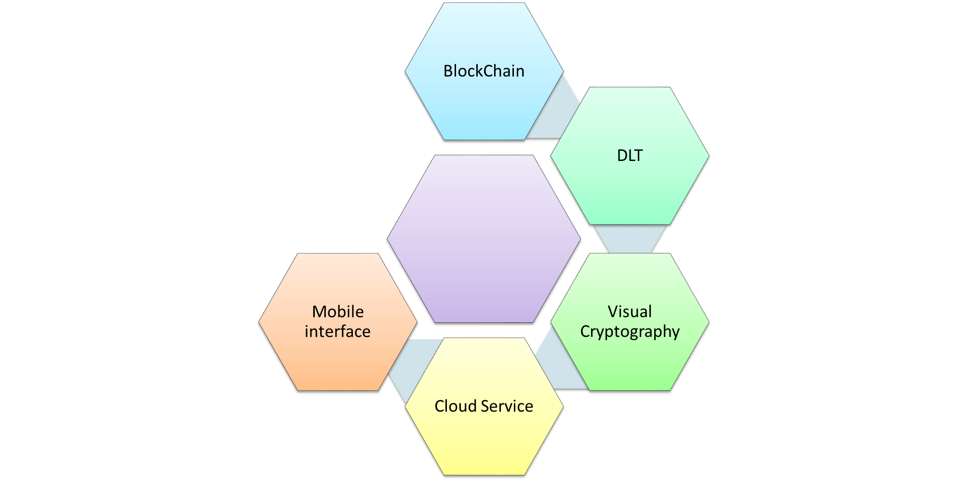
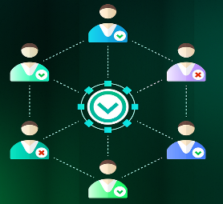

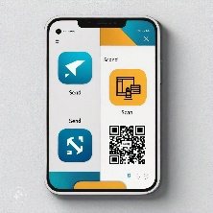
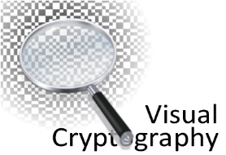


Slide 6
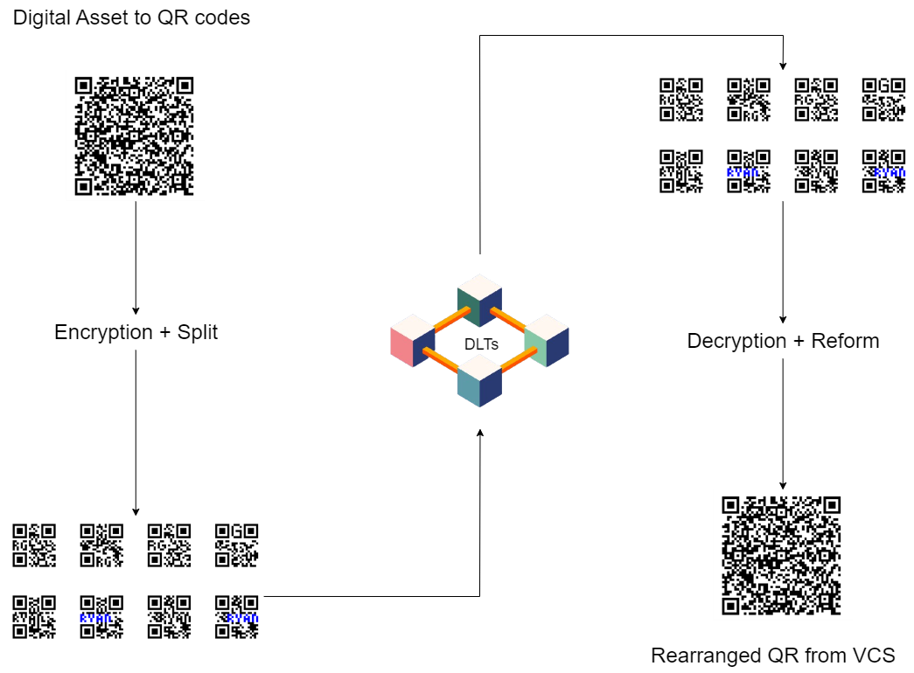
VCS

Slide 7
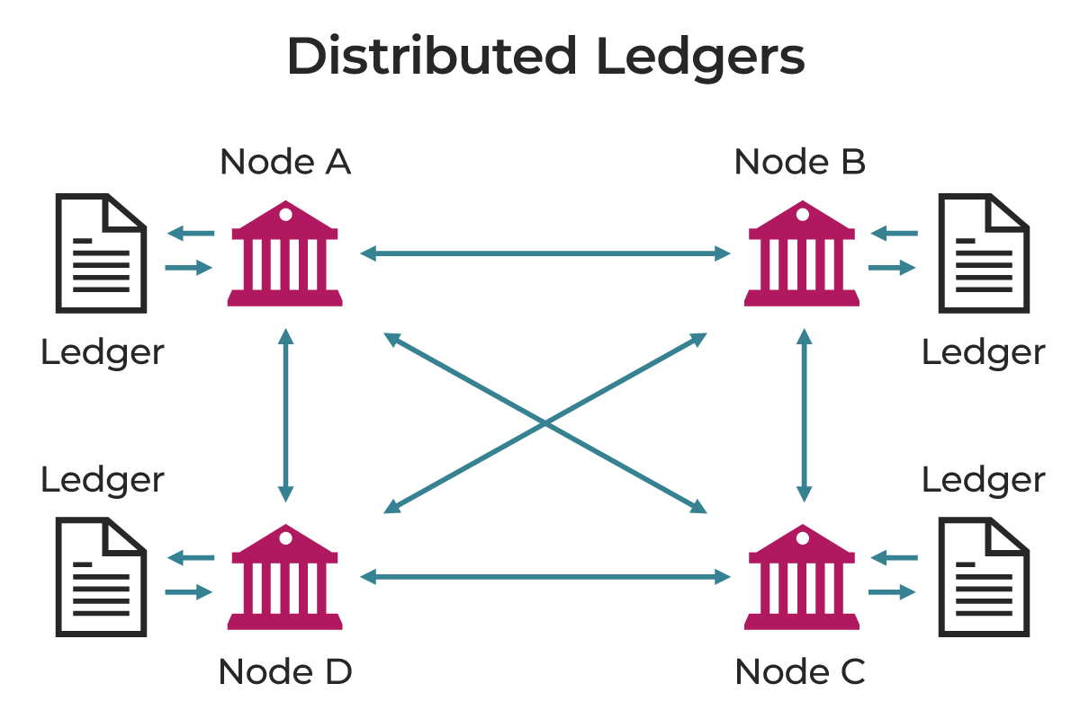
DLT

Slide 8
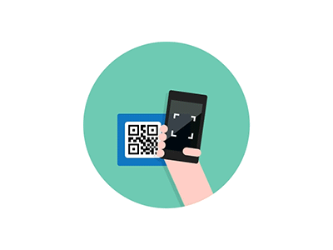
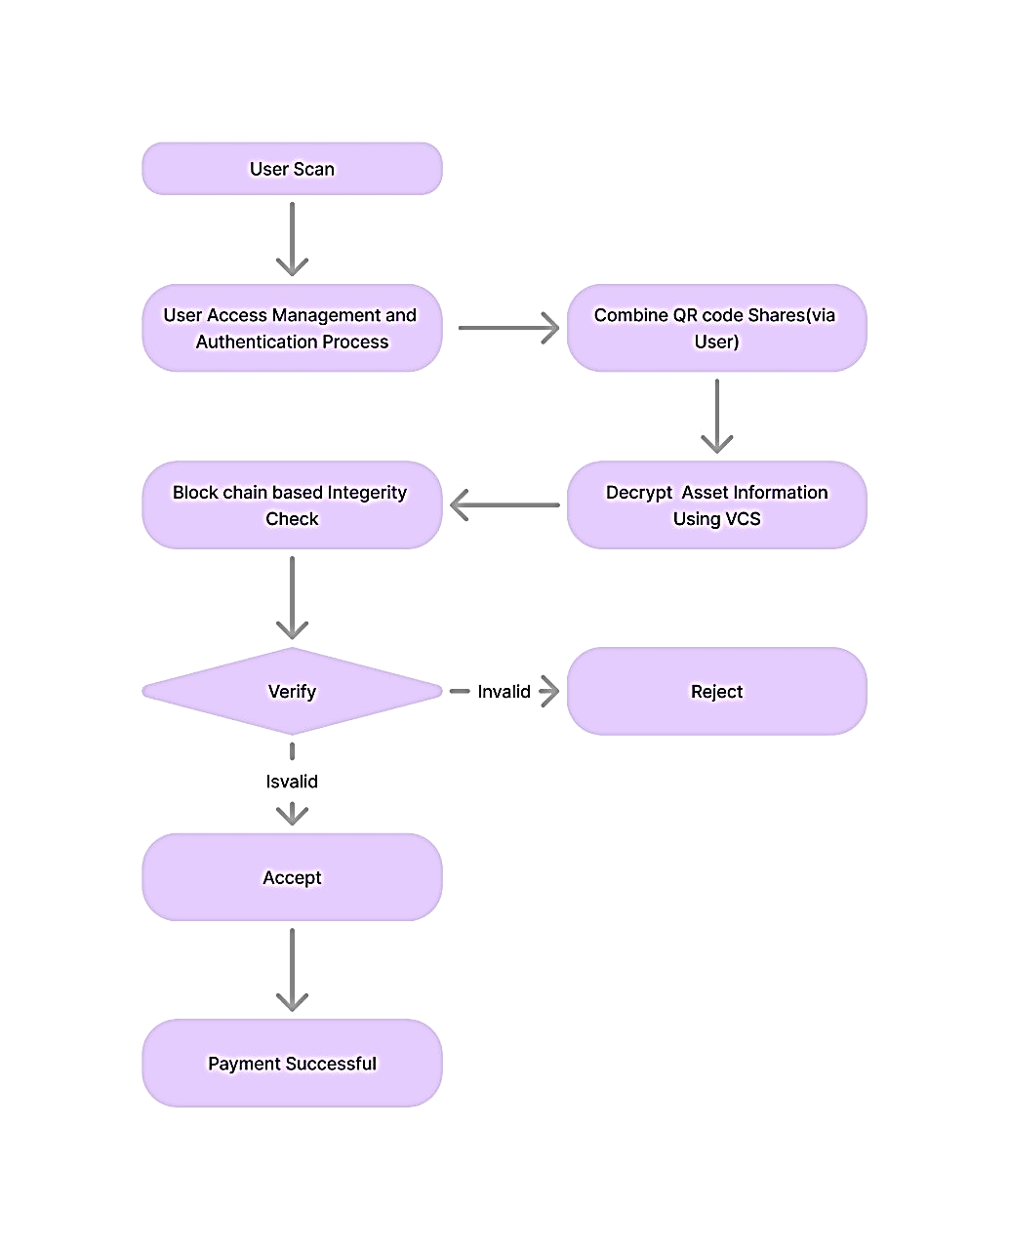
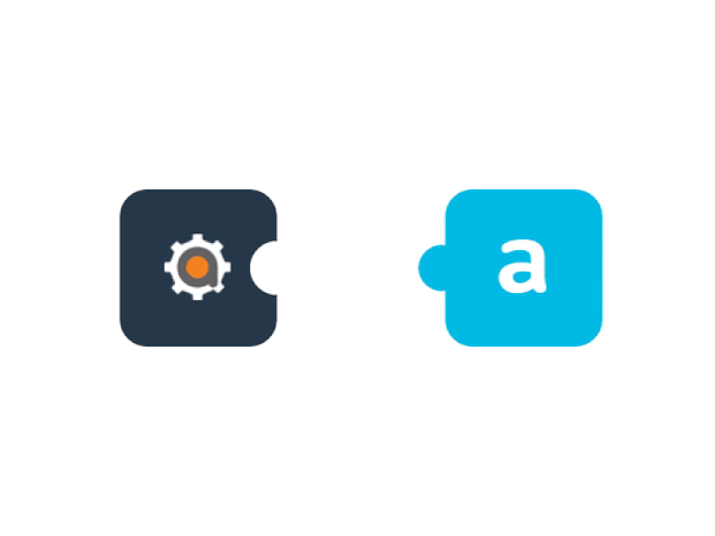
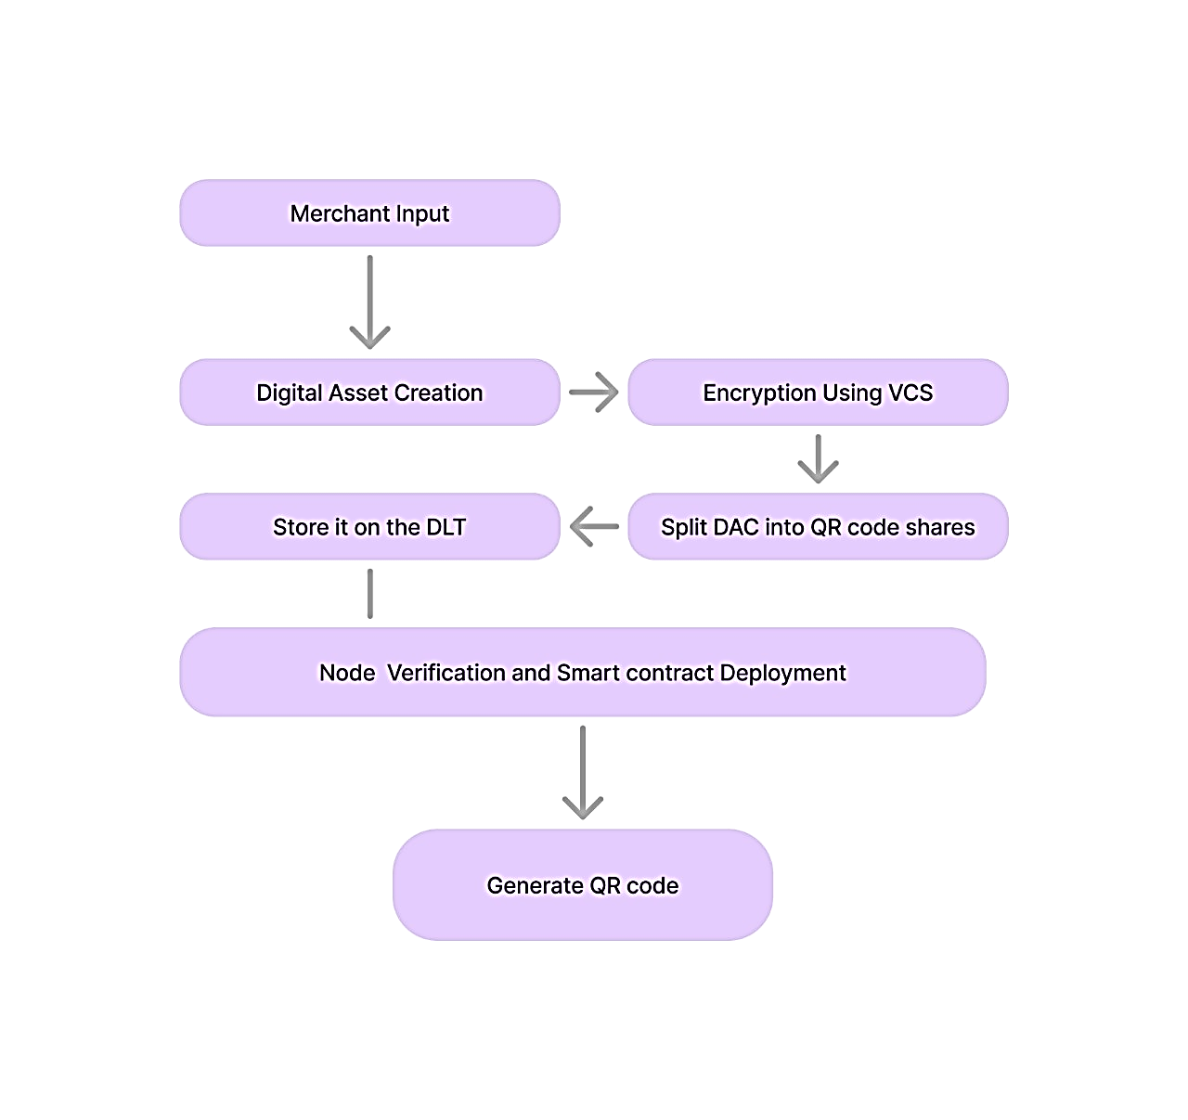

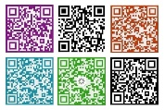

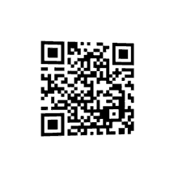


Design Strategy (project workflow/ system design/ DFD/UML design)
Visual Cryptographic System
a cryptographic technique which allows visual information (pictures, text, etc.) to be encrypted in such a way that the decrypted information appears as a visual image

Slide 9
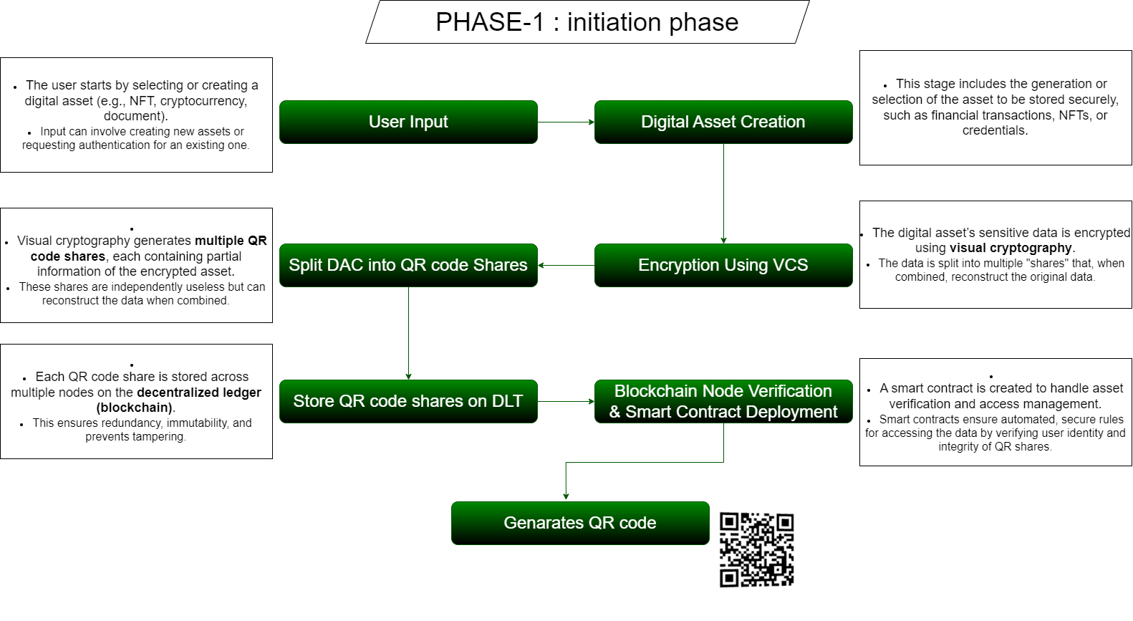

Slide 10
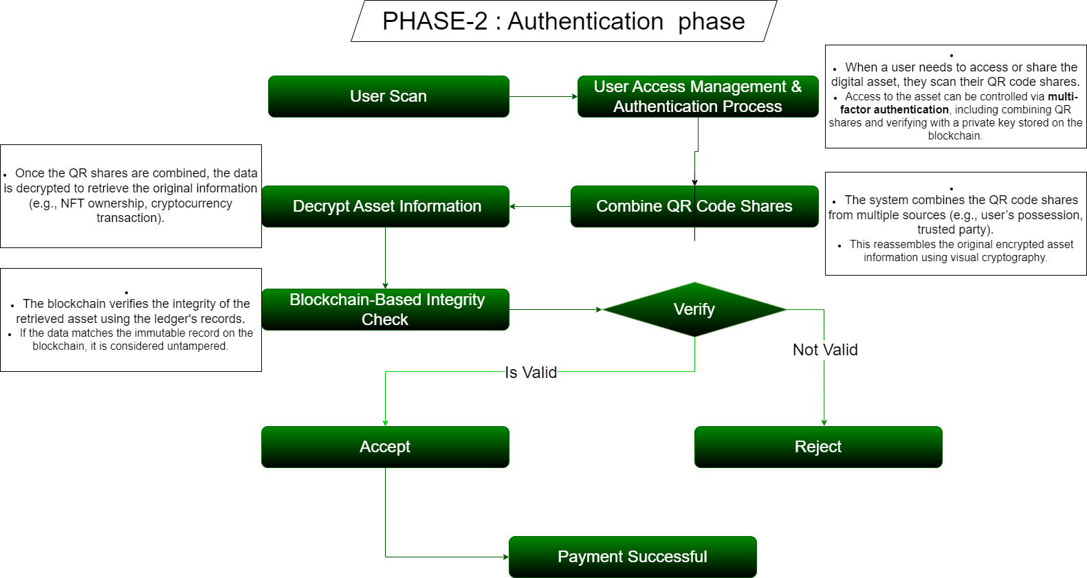

Slide 11


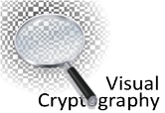

TECHNICAL APPROACH
 | Tech | Uses
 | BlockChain | Blockchain provides decentralized, tamper-proof storage, smart contracts for secure data handling and transparent tracking.
 | ReactNative | React Native is a popular framework for building mobile applications using JavaScript and React, allowing developers to create cross-platform apps for both iOS and Android with a single codebase.
 | Visual Cryptography | Visual cryptography securely splits sensitive information into encrypted shares, which are embedded in QR codes. Only by combining all the shares can the original data be reconstructed, ensuring privacy and protection against unauthorized access.
 | Cloud Service | Cloud services provide scalable infrastructure for storing and processing cryptographic shares and blockchain data.
 | Mobile Application | A user friendly mobile application

Slide 12
Conclusion
This project introduces a system that integrates blockchain with visual cryptography-enhanced QR codes to improve data security, privacy, and trust. Blockchain's decentralized and immutable nature provides a secure foundation for storing sensitive information, while visual cryptography splits data into encrypted shares embedded in QR codes. These shares can only be combined to reveal the original information, ensuring privacy. Smart contracts automate and verify transactions, enabling secure, transparent data handling. Potential applications include secure financial transactions, digital identity management, and supply chain transparency, offering decentralized, secure ecosystems for users.

Slide 13
References
Journals
S. Nakamoto, “Bitcoin: A peer-to-peer electronic cash system,” Decentralized Bus. Rev., 2008, Art. no. 21260.
V. Buterin , “A next-generation smart contract and decentralized application platform,” White Paper, vol. 3, no. 37, pp. 2–1, 2014.
L. Zhong, Q. Wu, J. Xie, J. Li, and B. Qin, “A secure versatile light payment system based on blockchain,” Future Gener. Comput. Syst., vol. 93, pp. 327–337, Apr.2019
A Centralized Data Validation System Model for Healthcare Systems Based on Blockchain, Year: 2021, Pages: 55-58DOI,Bookmark: 10.1109/ICSIoT55070.2021.00019
Design of a Blockchain-Based Secure Storage Architecture for Resource-Constrained Healthcare,Year: 2023, Pages: 1-6DOI Bookmark: 10.1109/ISCC58397.2023.10218178

